Slide 1
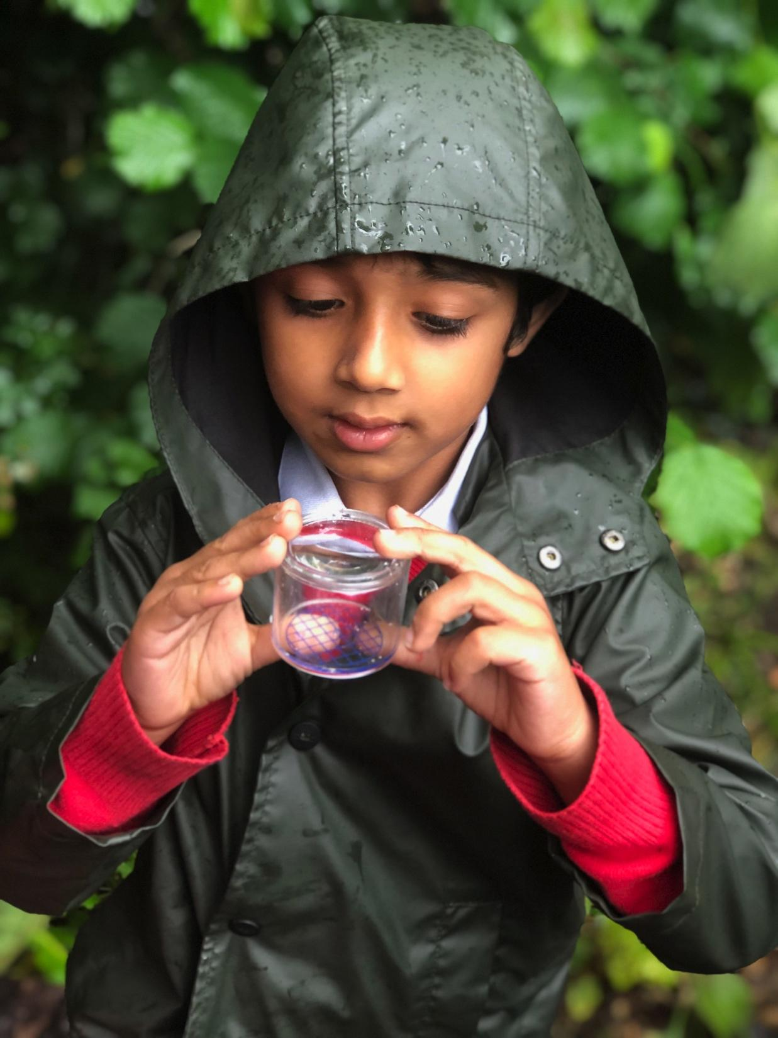
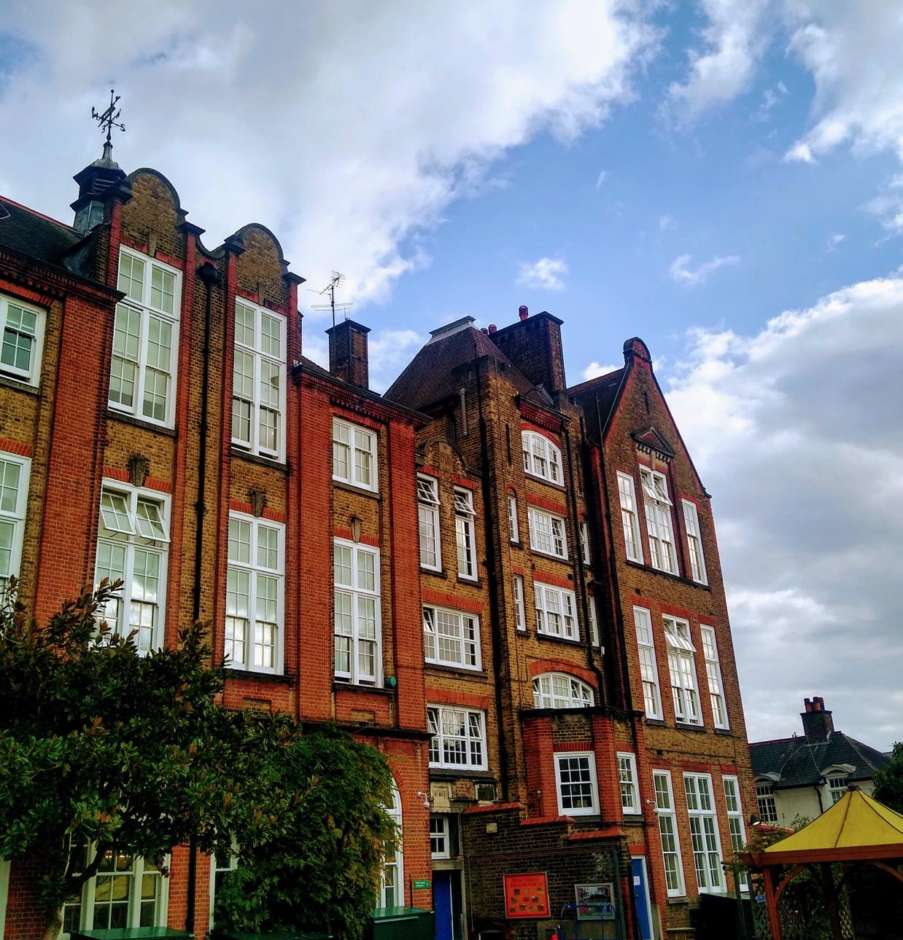
Welcome to Hotham
Open Event for Prospective Parents
Richard Byrne-Smith, Headteacher

Slide 2
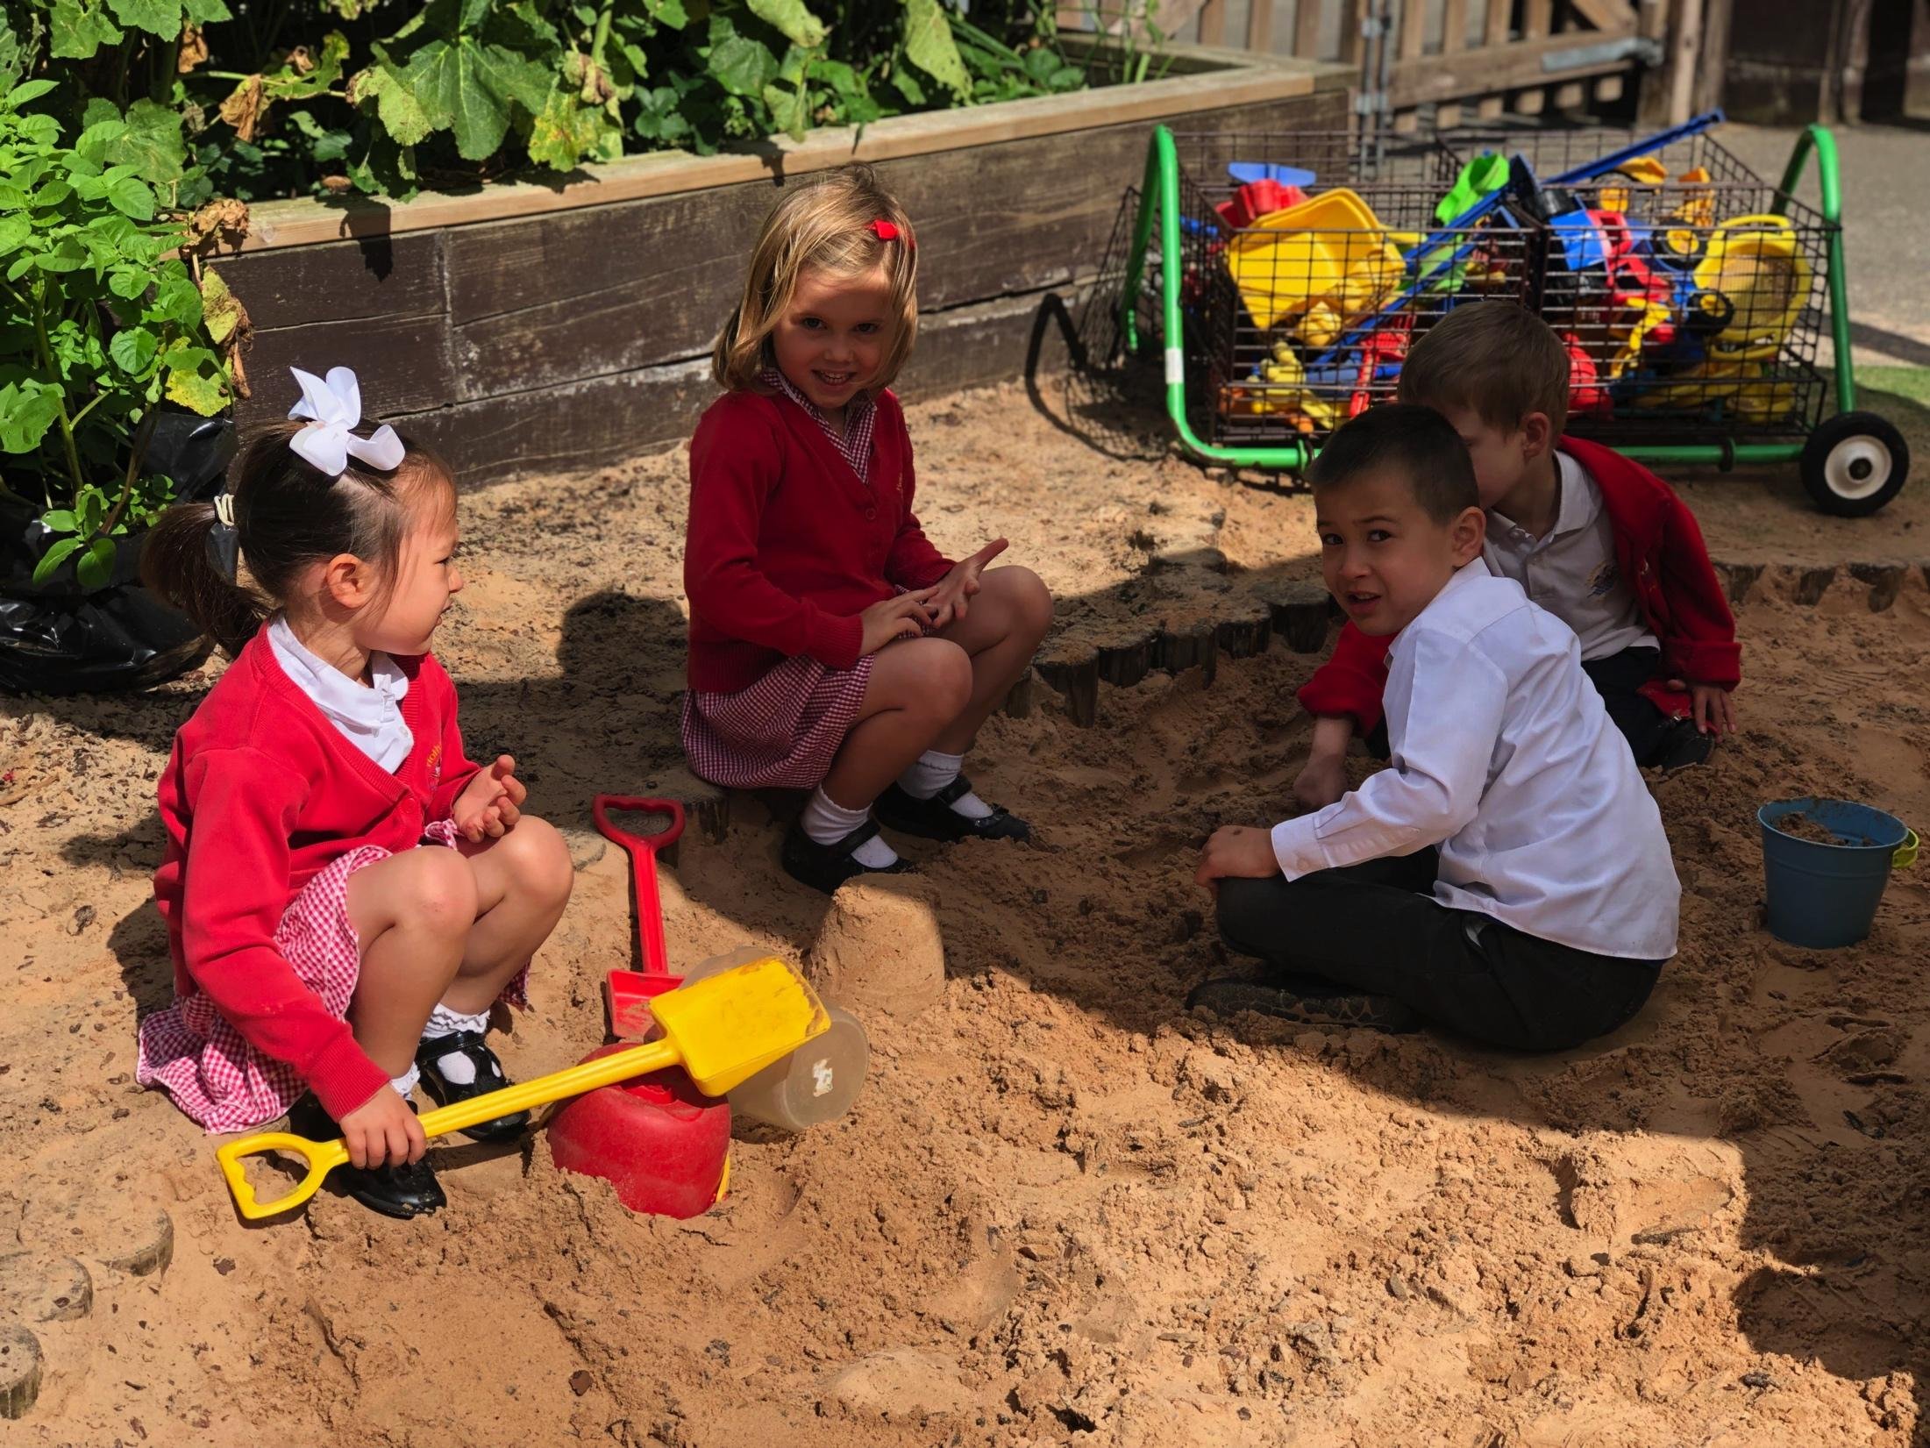
Welcome to our school!

Slide 3
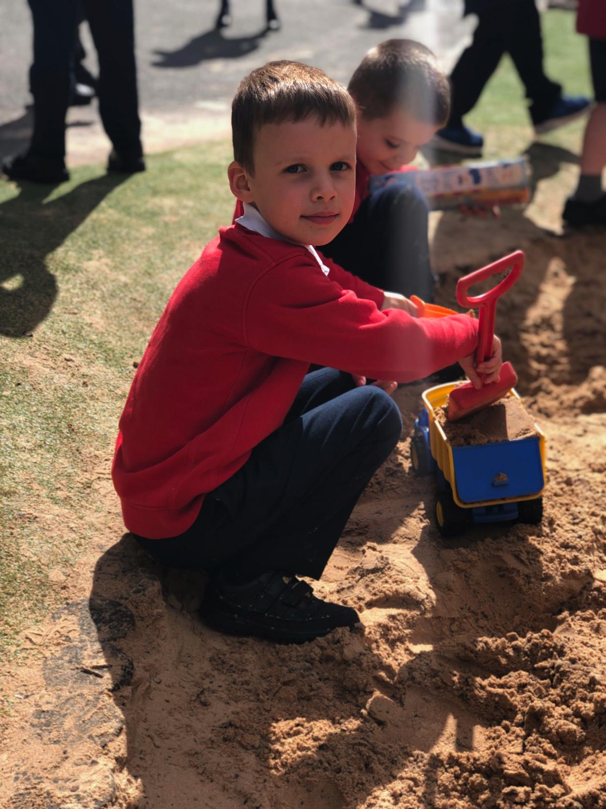
We will cover…
What our school is all about
Why our school is special
Early Years at Hotham
Our curriculum – what your child will learn here
How to find out more…

Slide 5
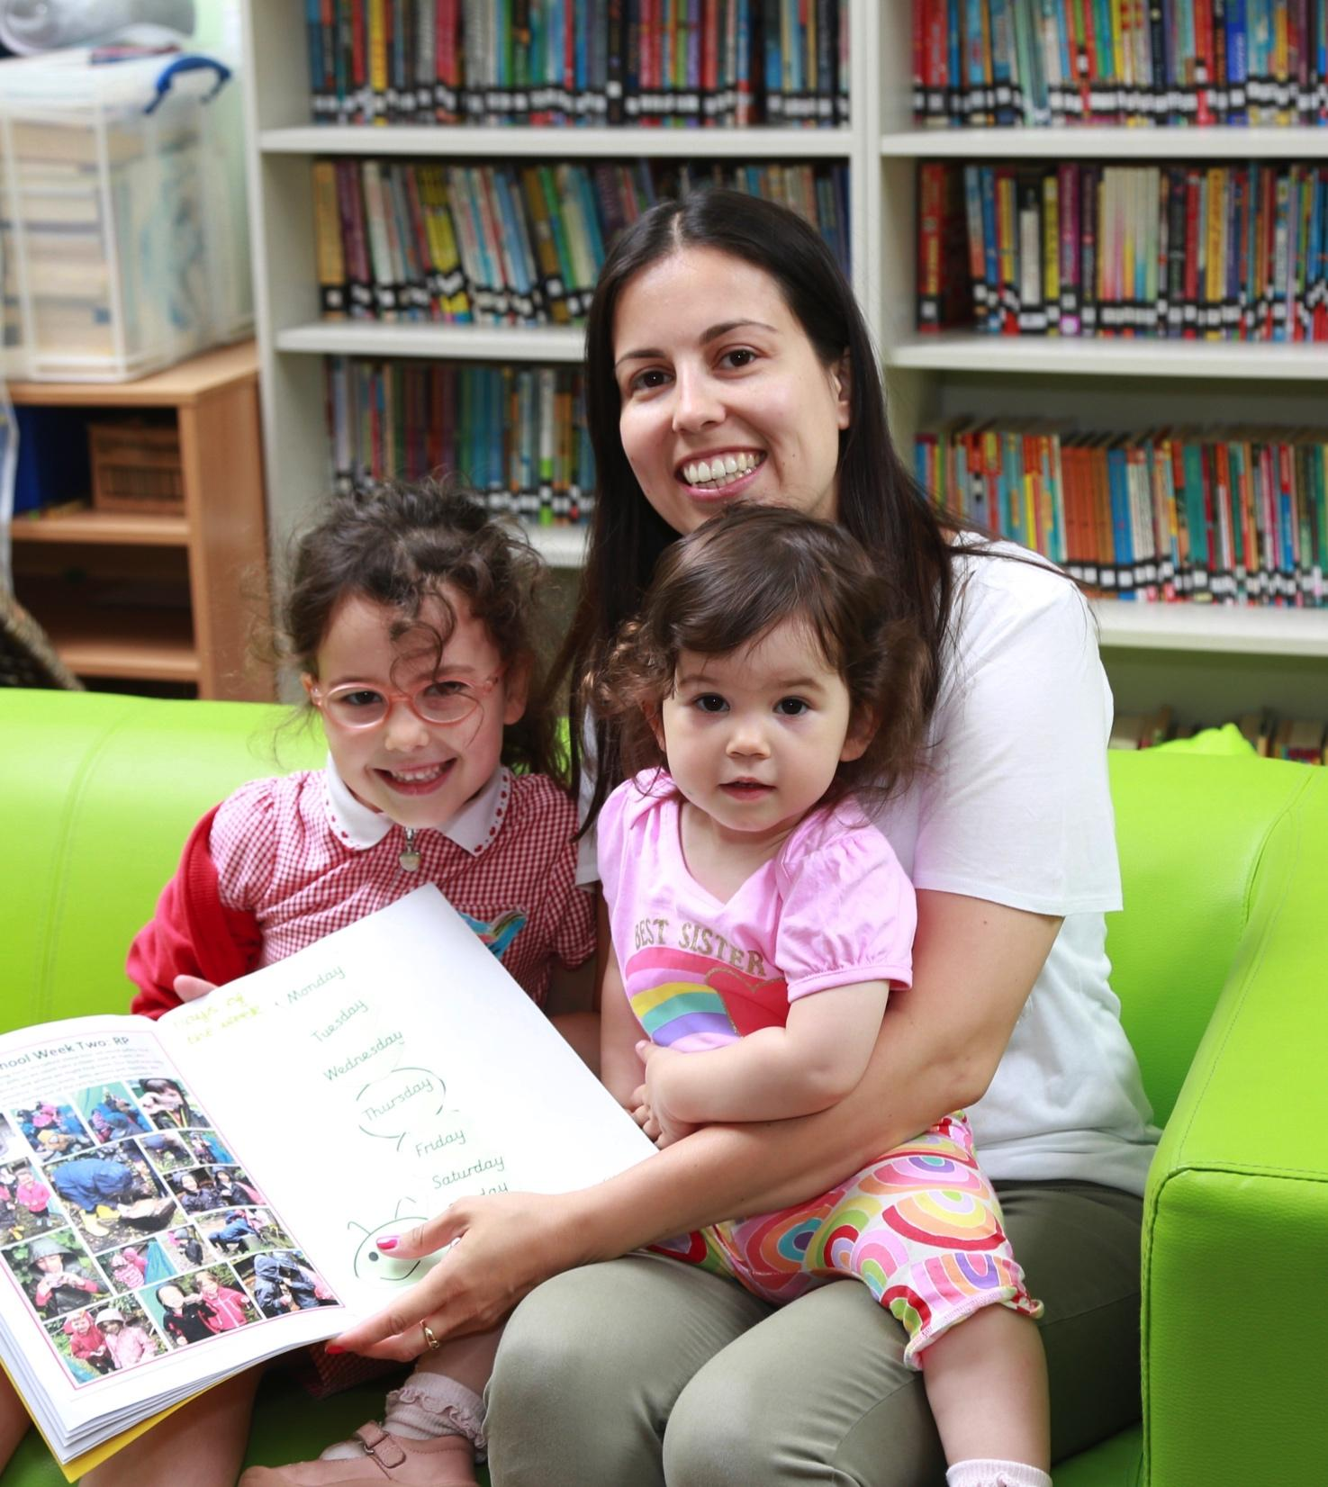
Our school in a nutshell
Hotham is a dynamic, caring and high-achieving school in the heart of Putney.
Everything we do here is for a purpose.
Our curriculum is well-known for its engaging and innovate projects. All children learn French from day one.
Our school site is unrivalled in the local area with its forest school and sports facilities.

Slide 6
Our Values

Slide 7
What makes Hotham special
We are a real community;
Everything we do is purposeful;
Our curriculum is innovate and delivered passionately;
Pupils achieve highly and expectations are ambitious;
We are fully inclusive school – known for our commitment;
Children learn a second language (French) from the minute they start;
We have exciting plans for the future…

Slide 8
Early Years at Hotham
One Nursery Class
Available full or part time
Two Reception Classes
Shared outdoor area
Excellence and expertise within the team
Children learn through play, mixed with direct input from the teacher
Focus on early reading and phonics
Learning journeys which document pupil progress

Slide 9
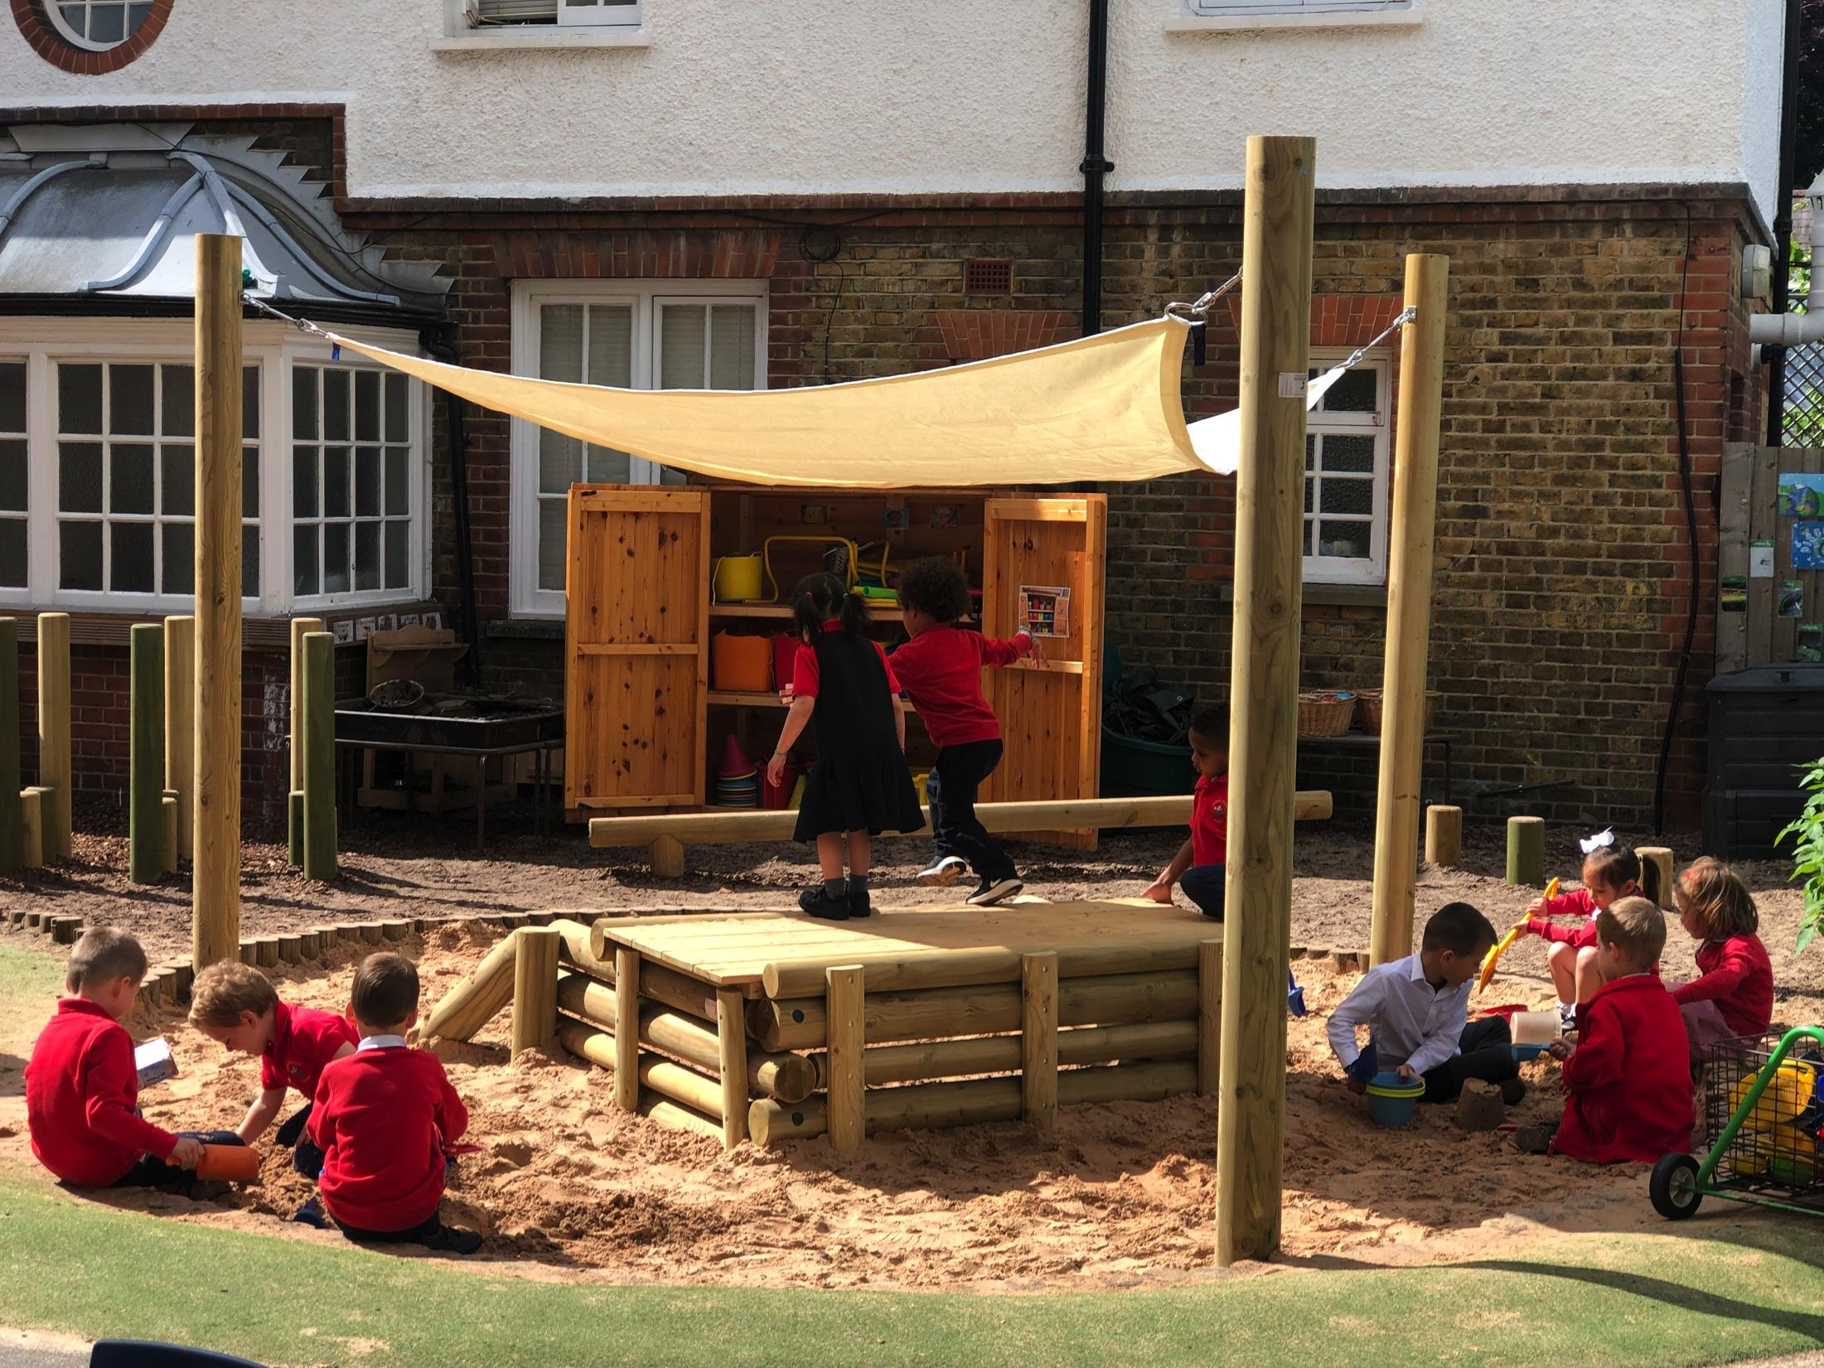
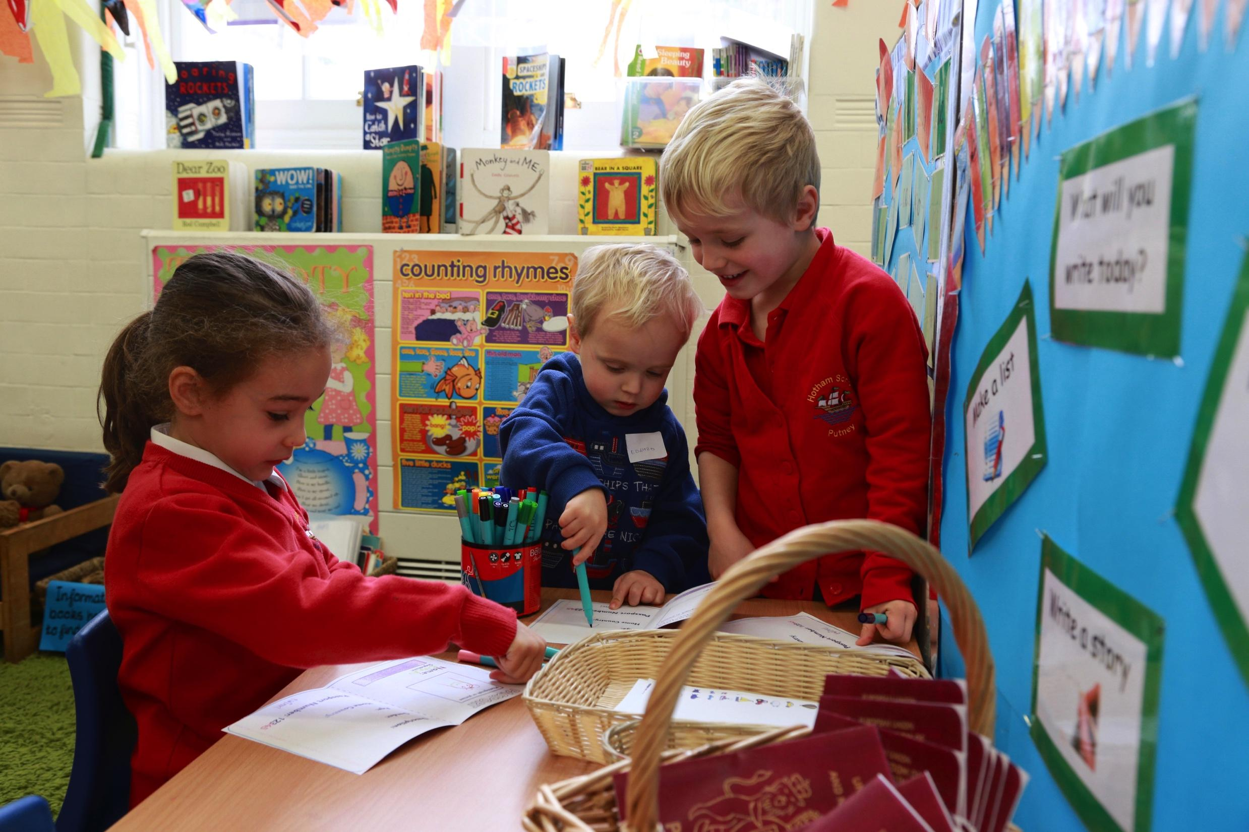
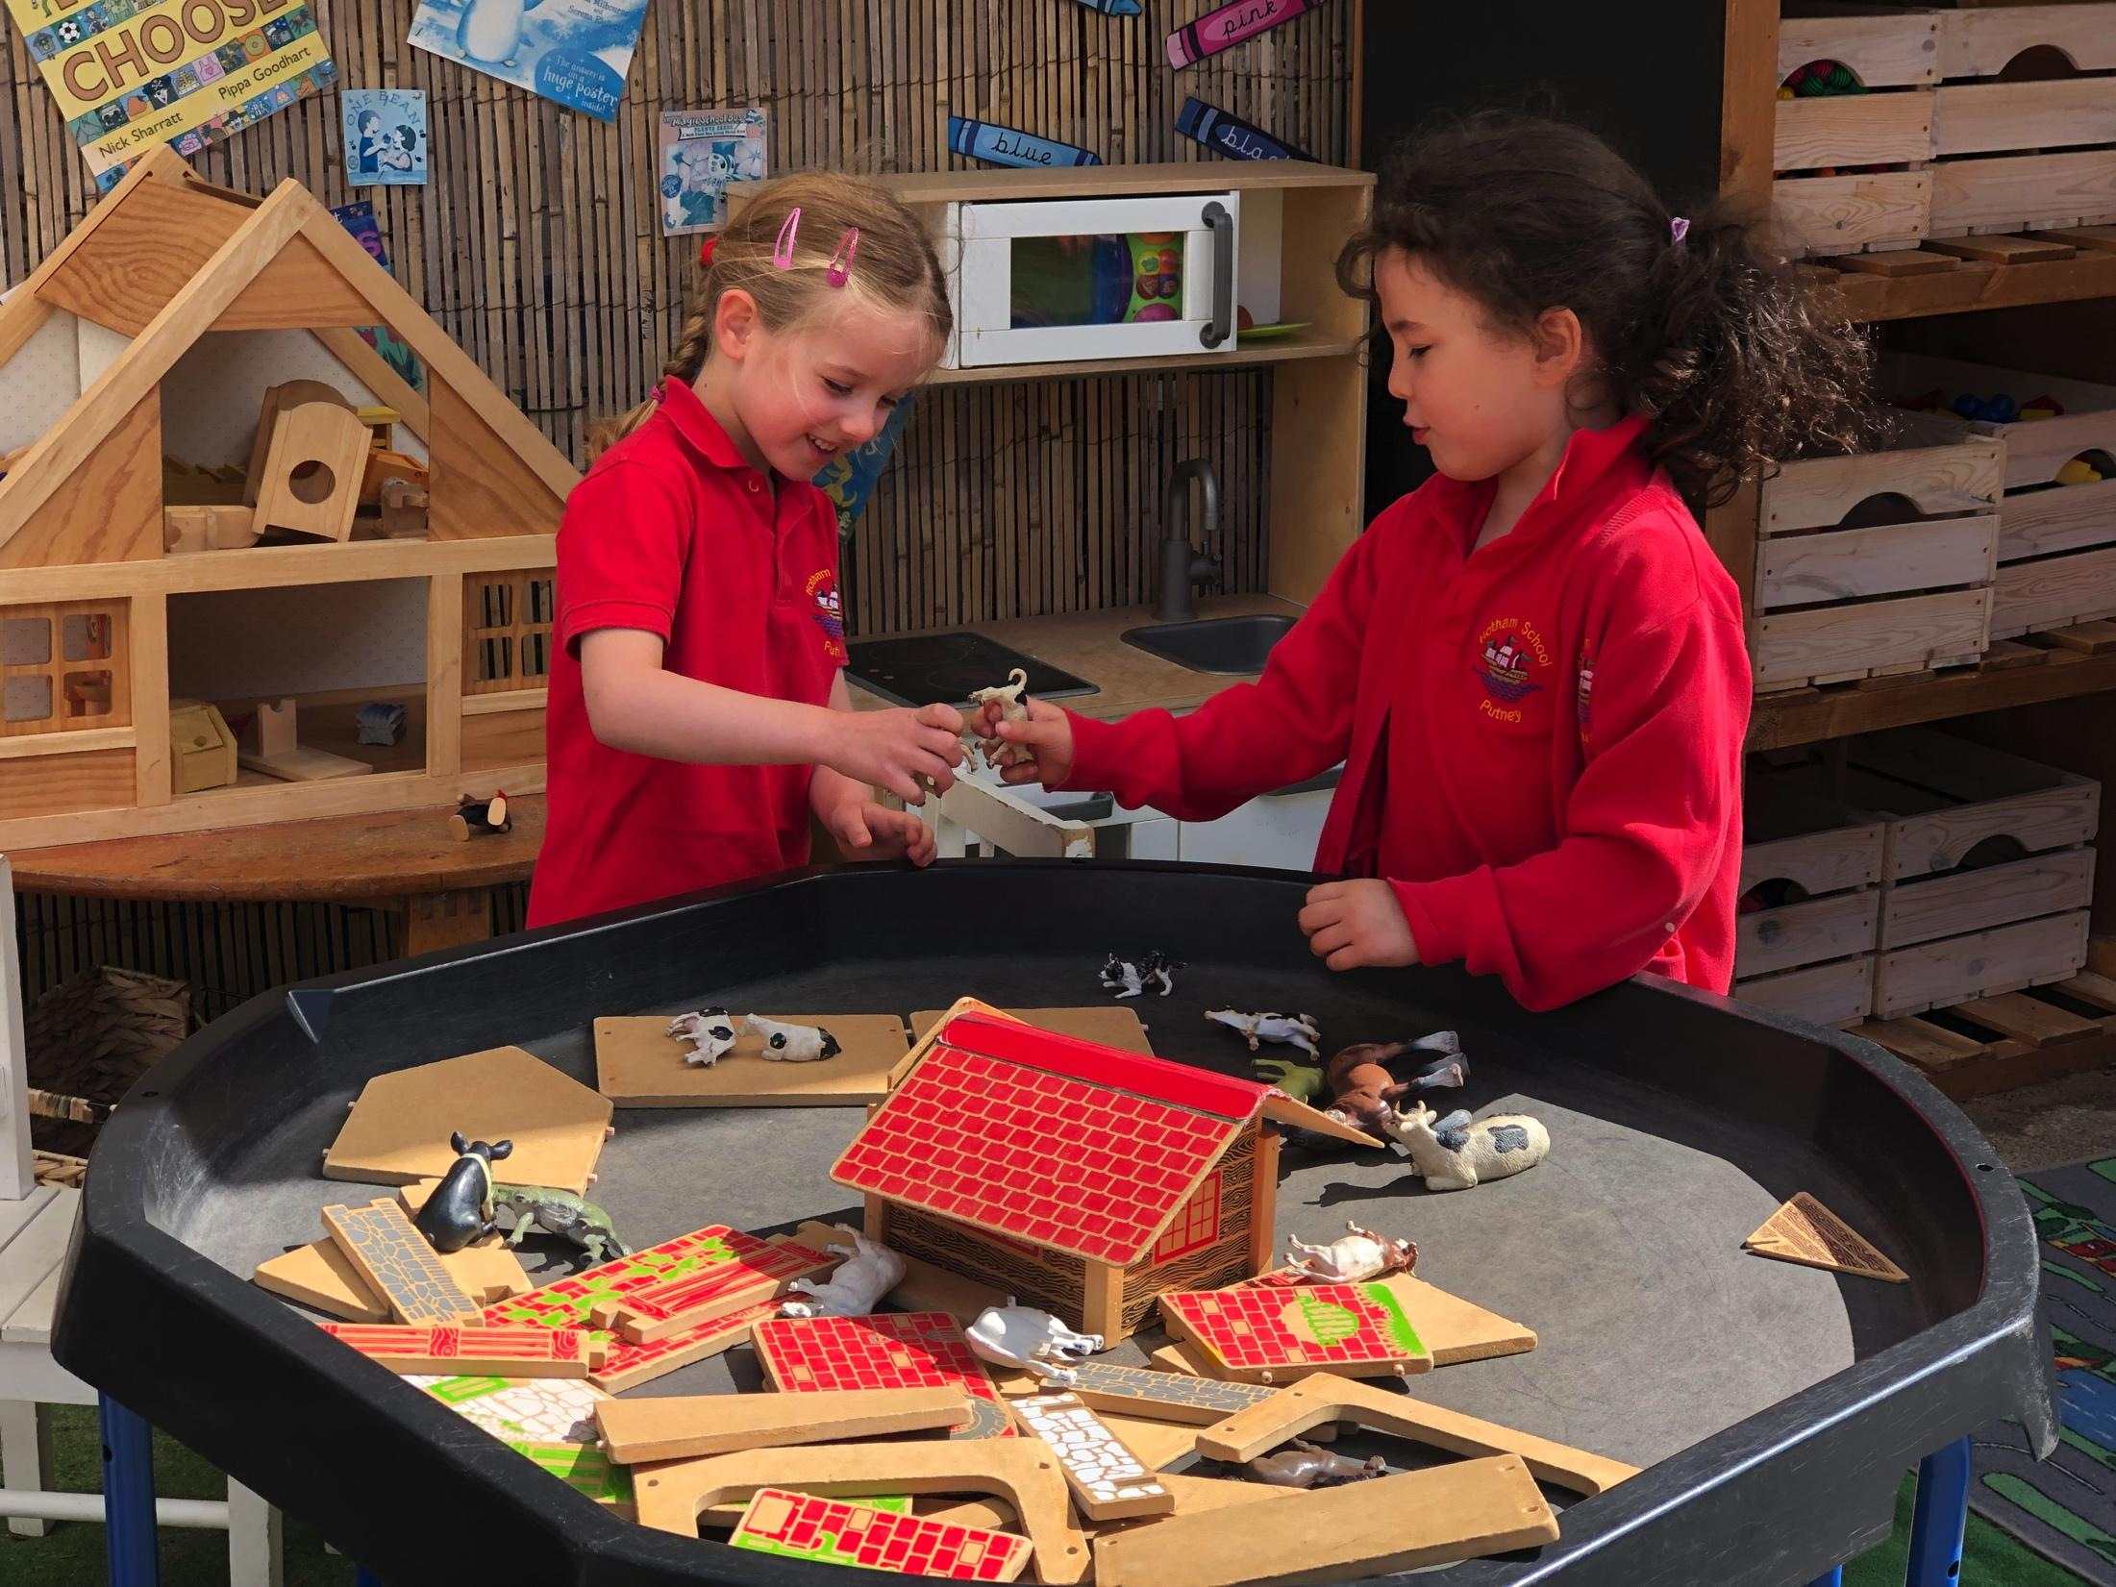

Slide 10
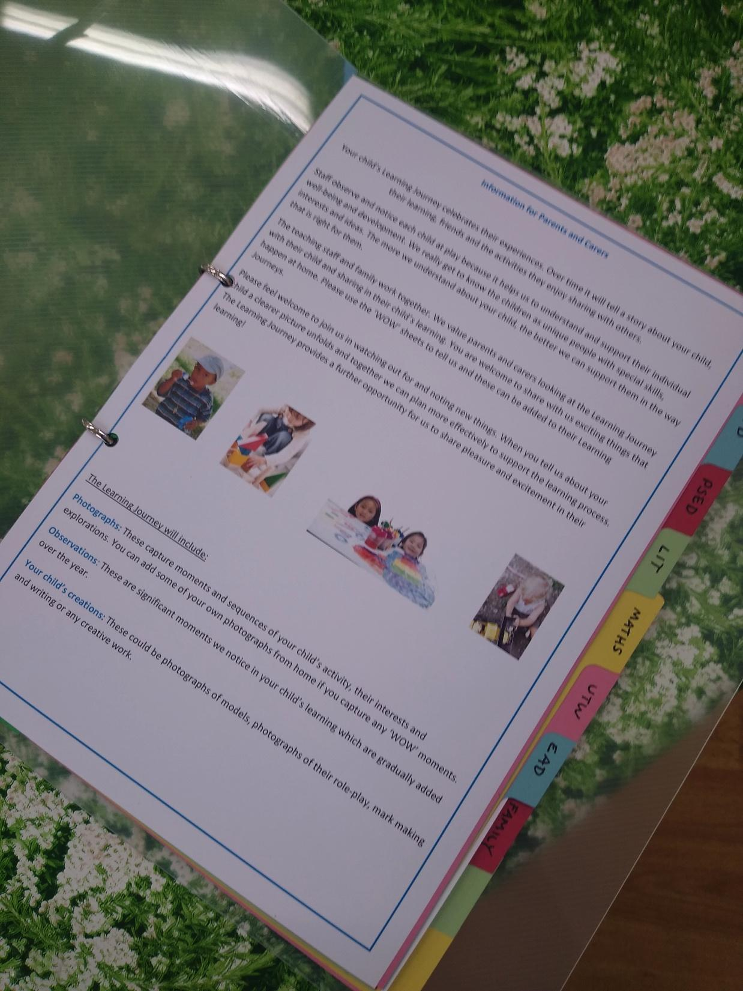
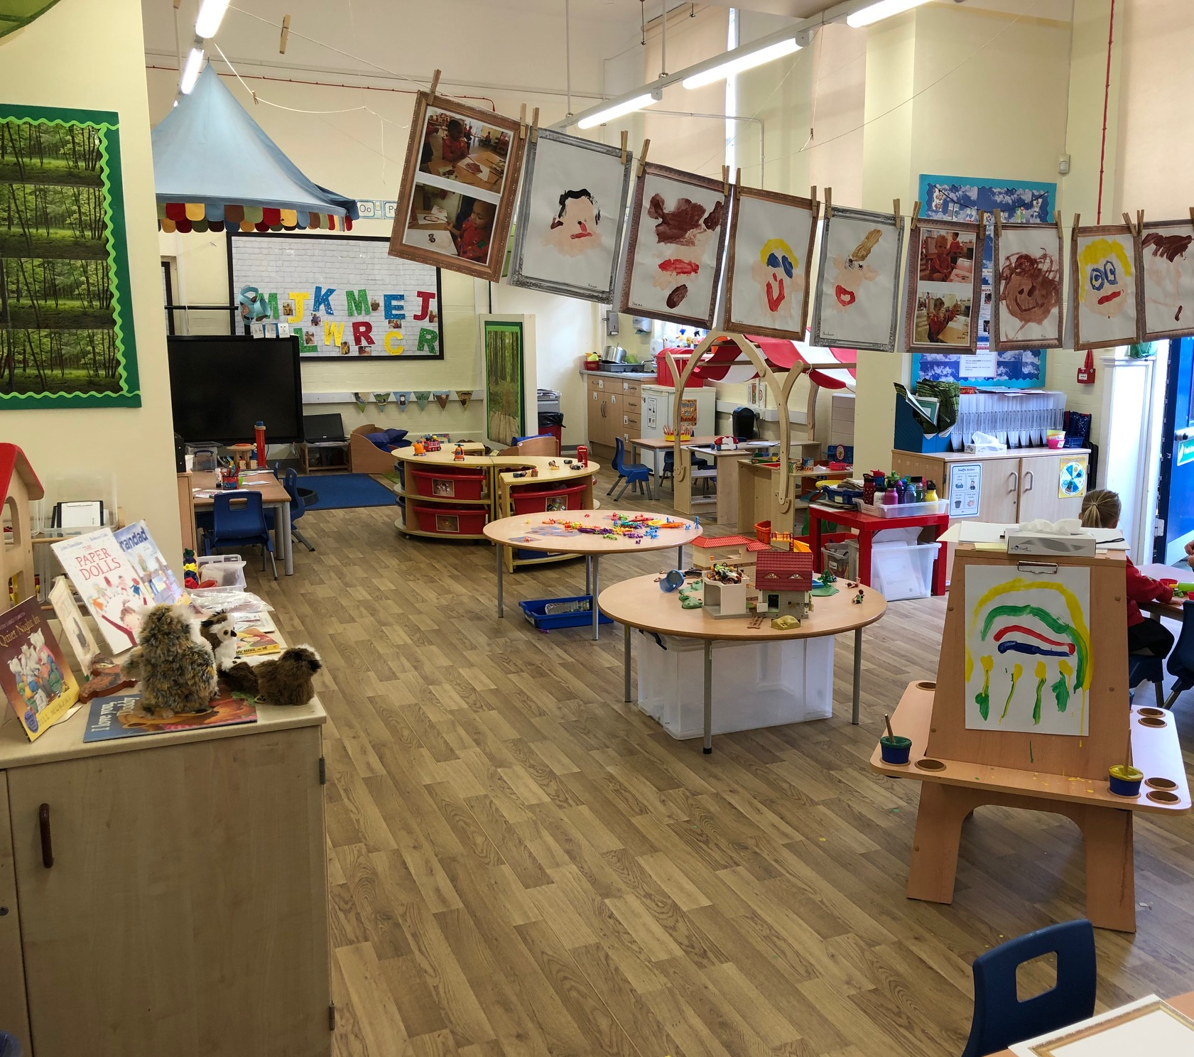
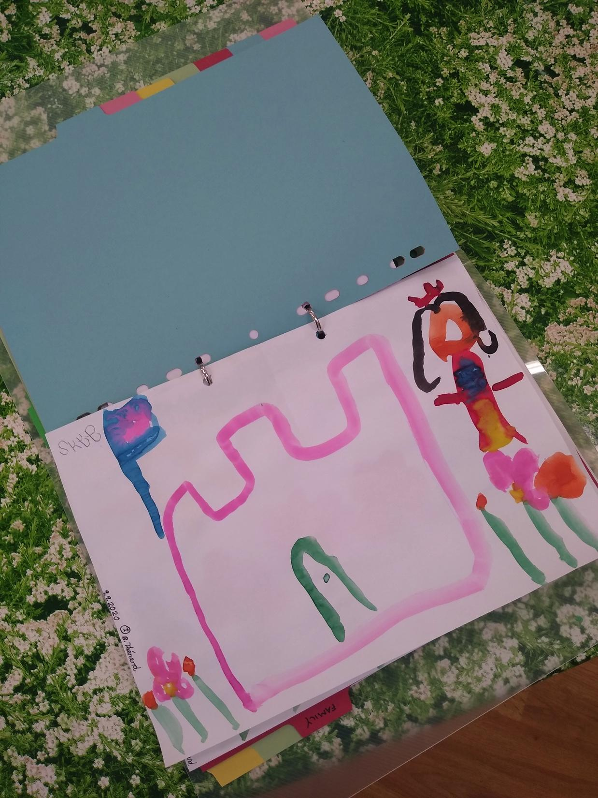

Slide 11
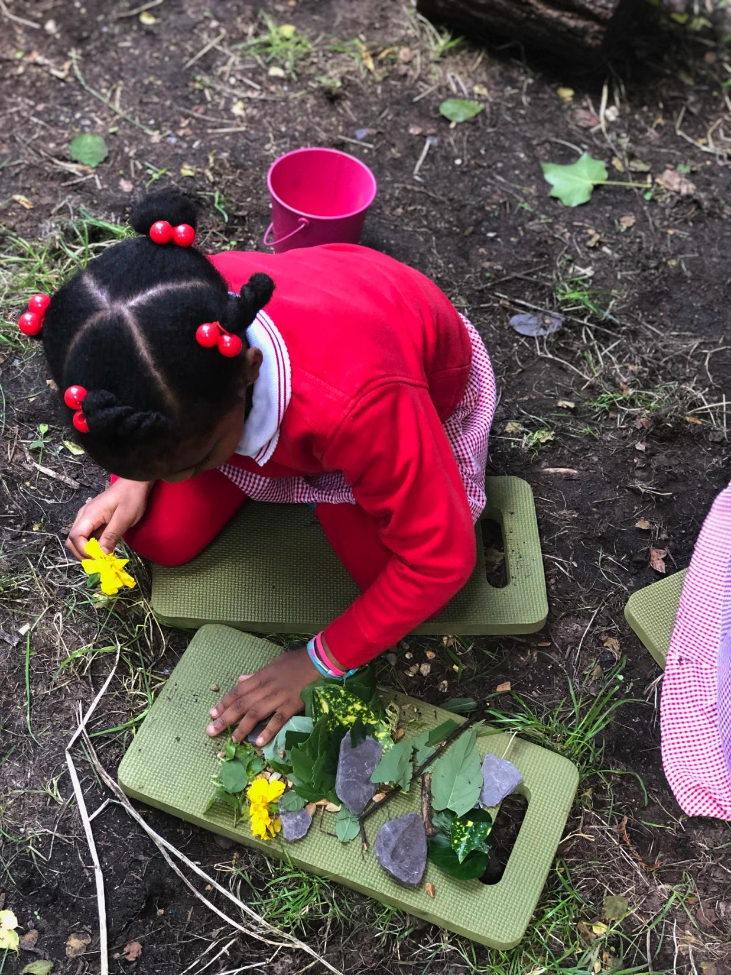
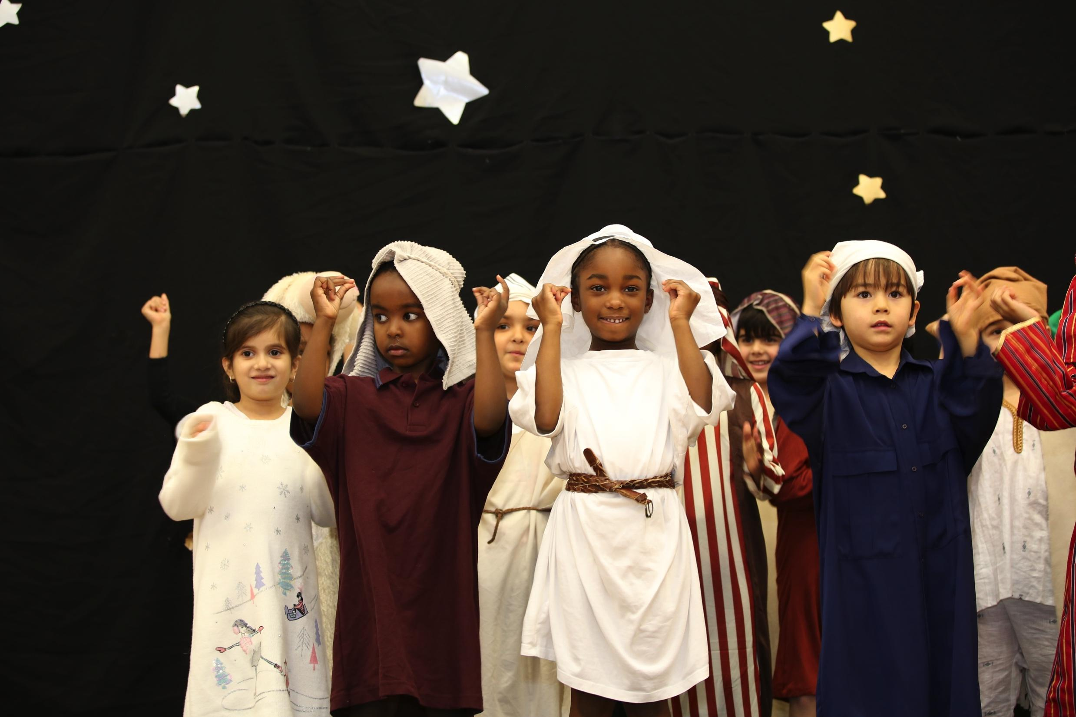

Slide 12
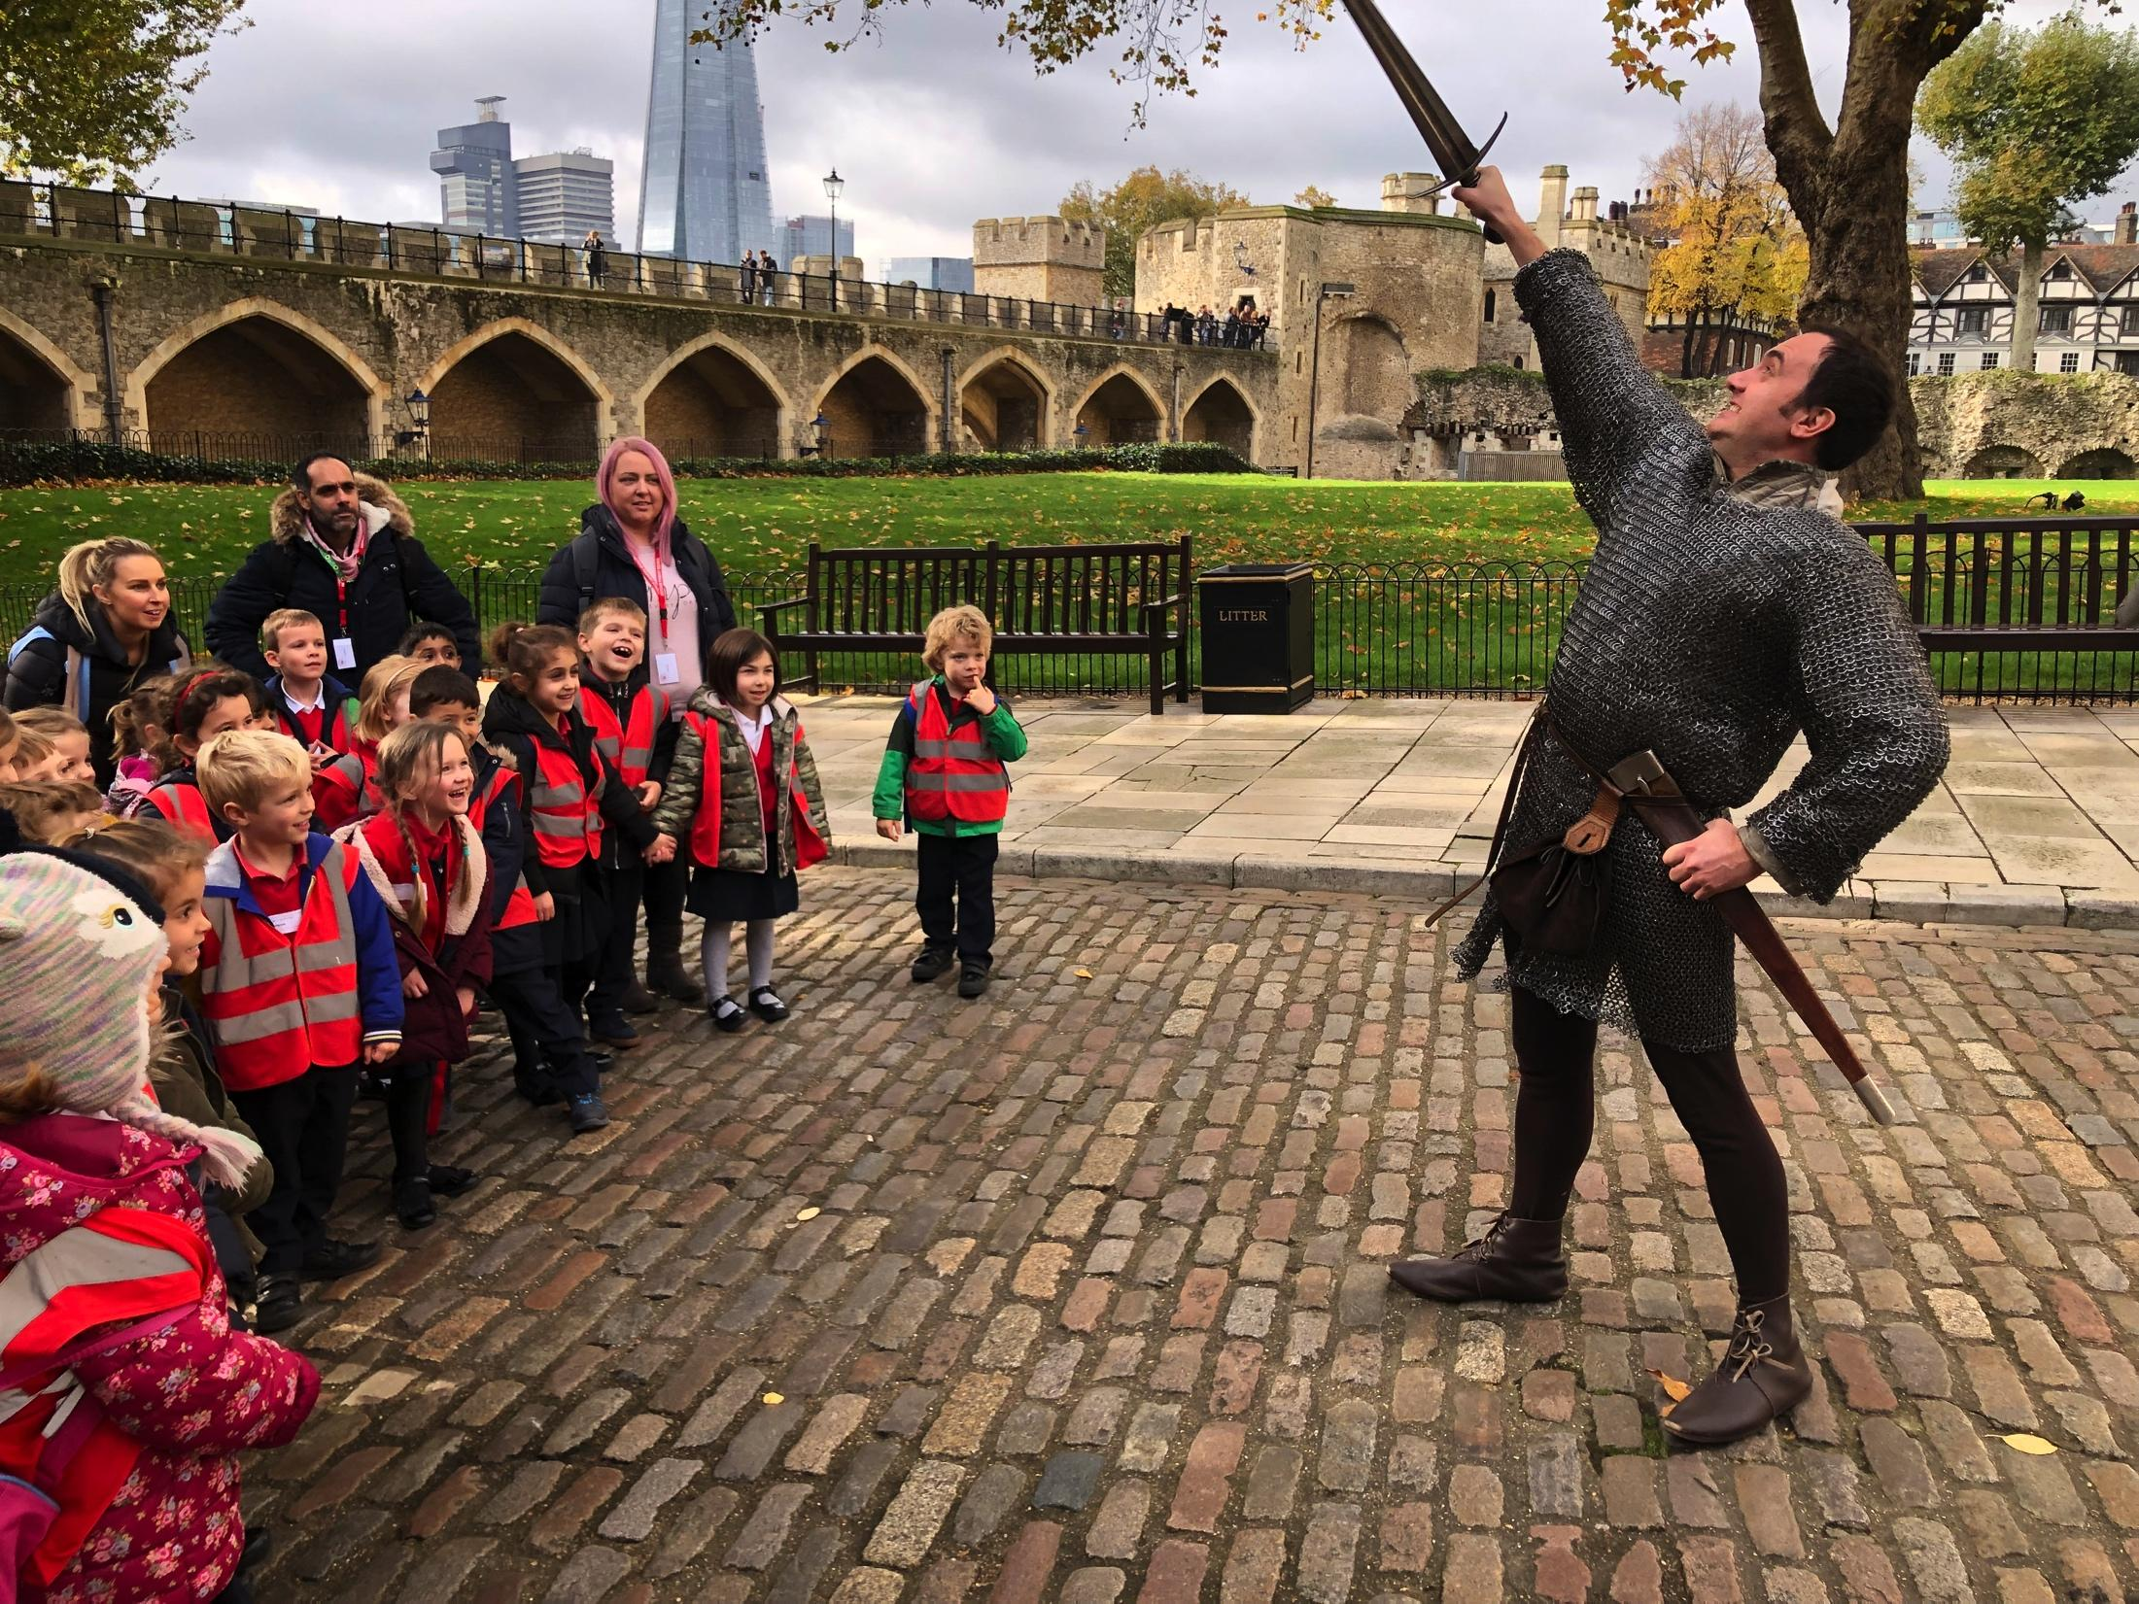
Our curriculum
Projects provide rich links between English and some foundation subjects
Essential question
Legacy outcomes
Knowledge progression
Maths, computing, science taught rigorously and discretely
PE and Music taught by specialist staff

Slide 13
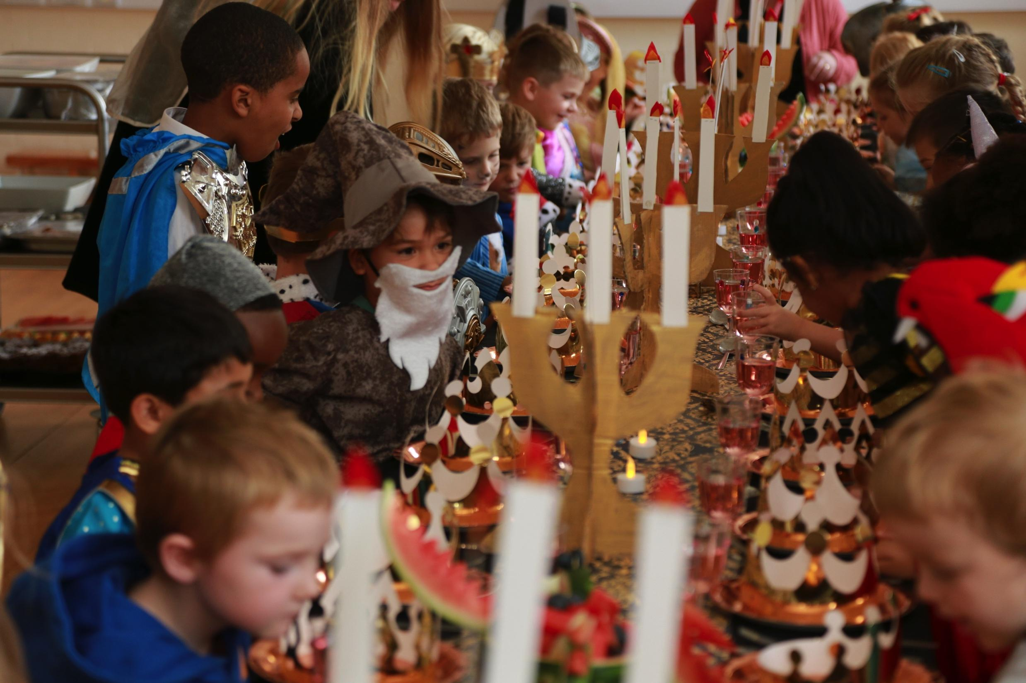
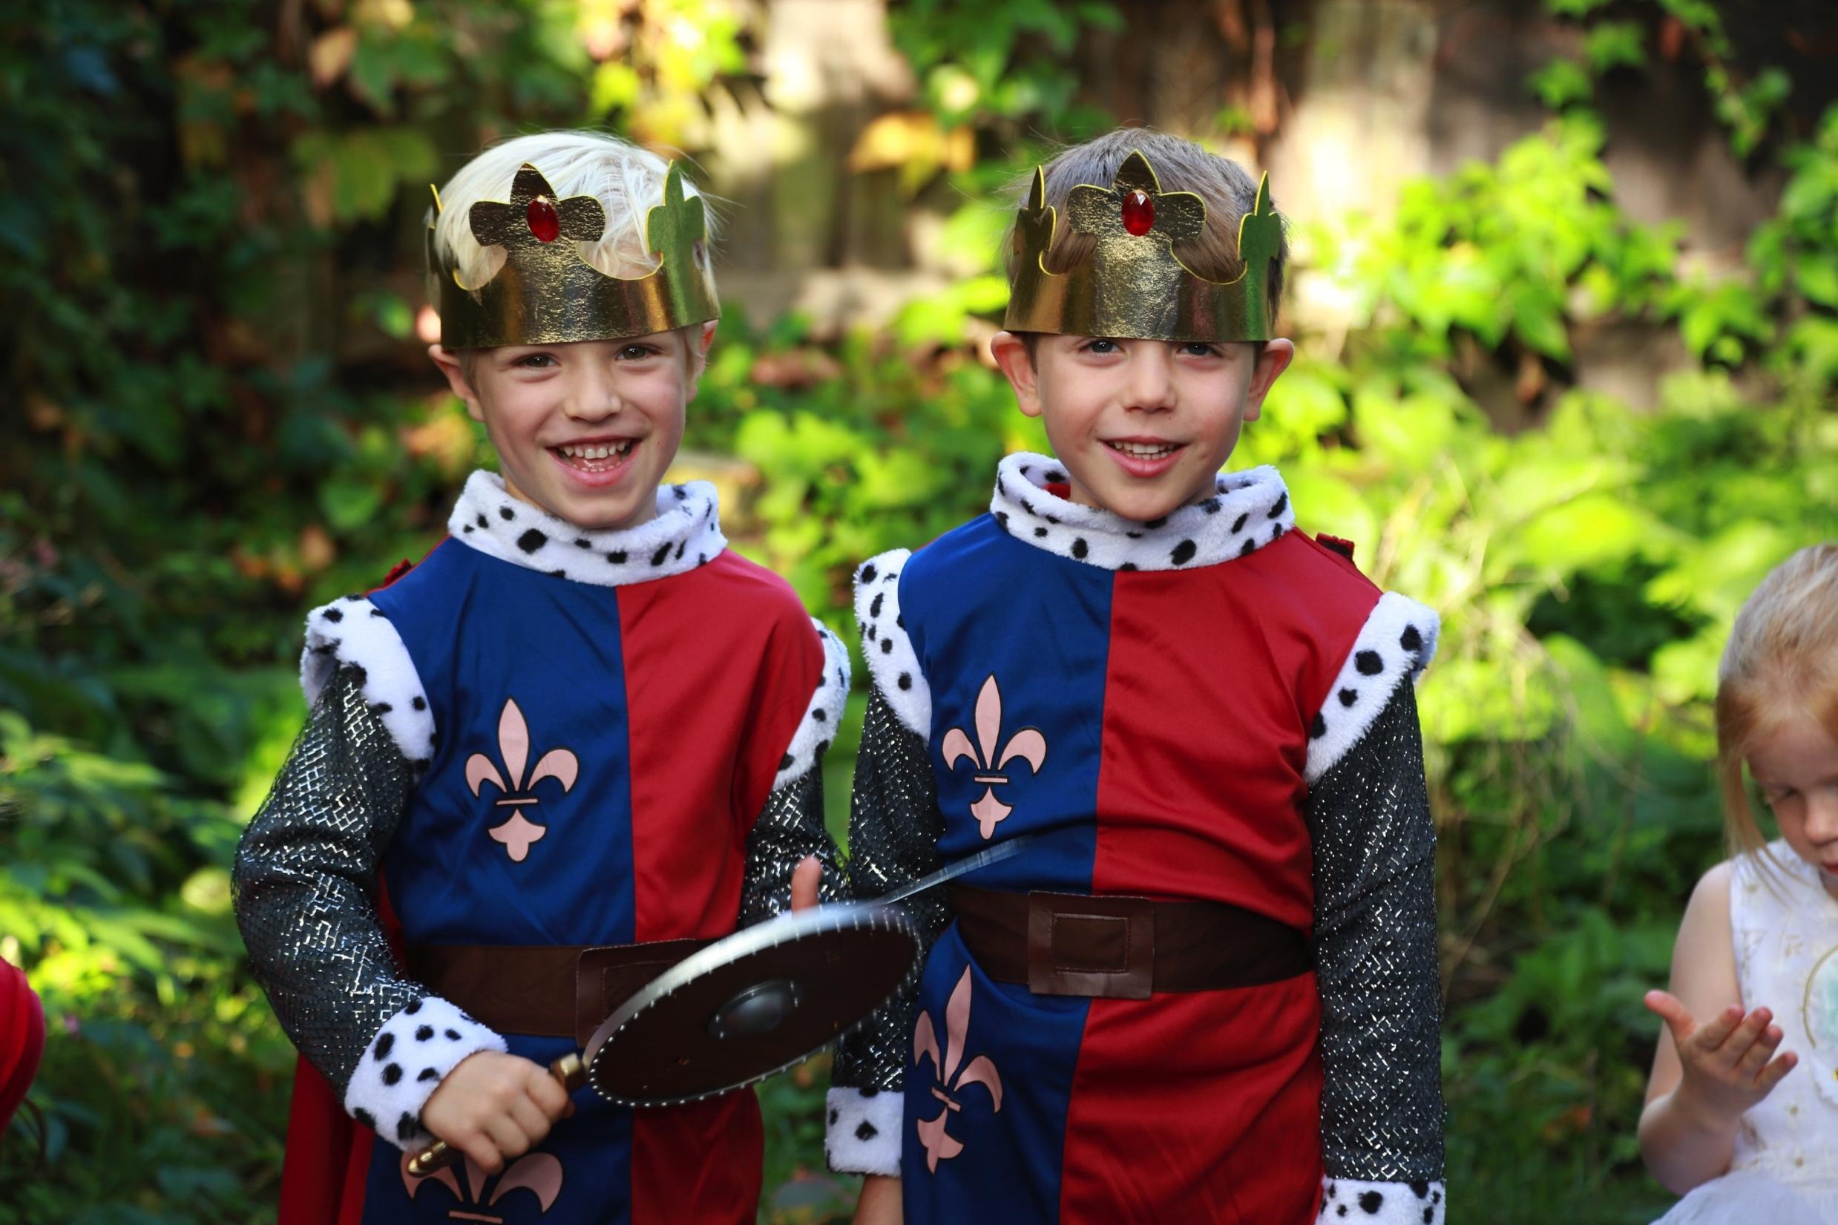
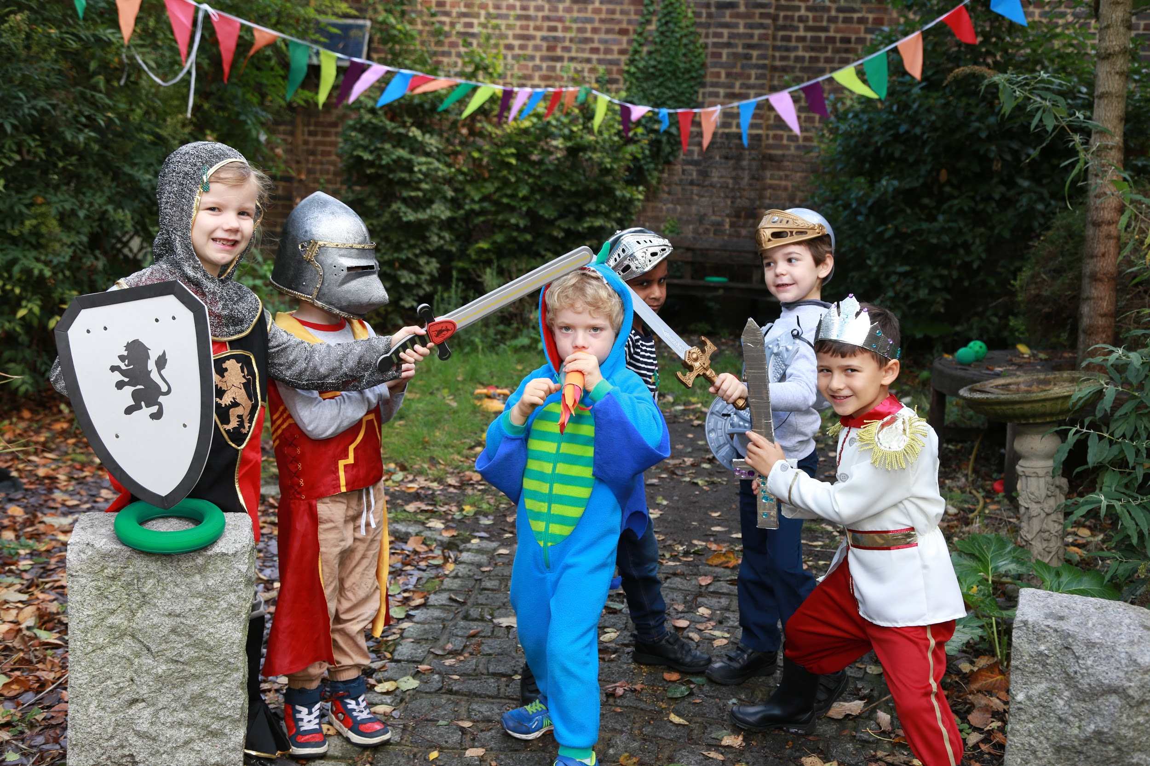

Slide 14
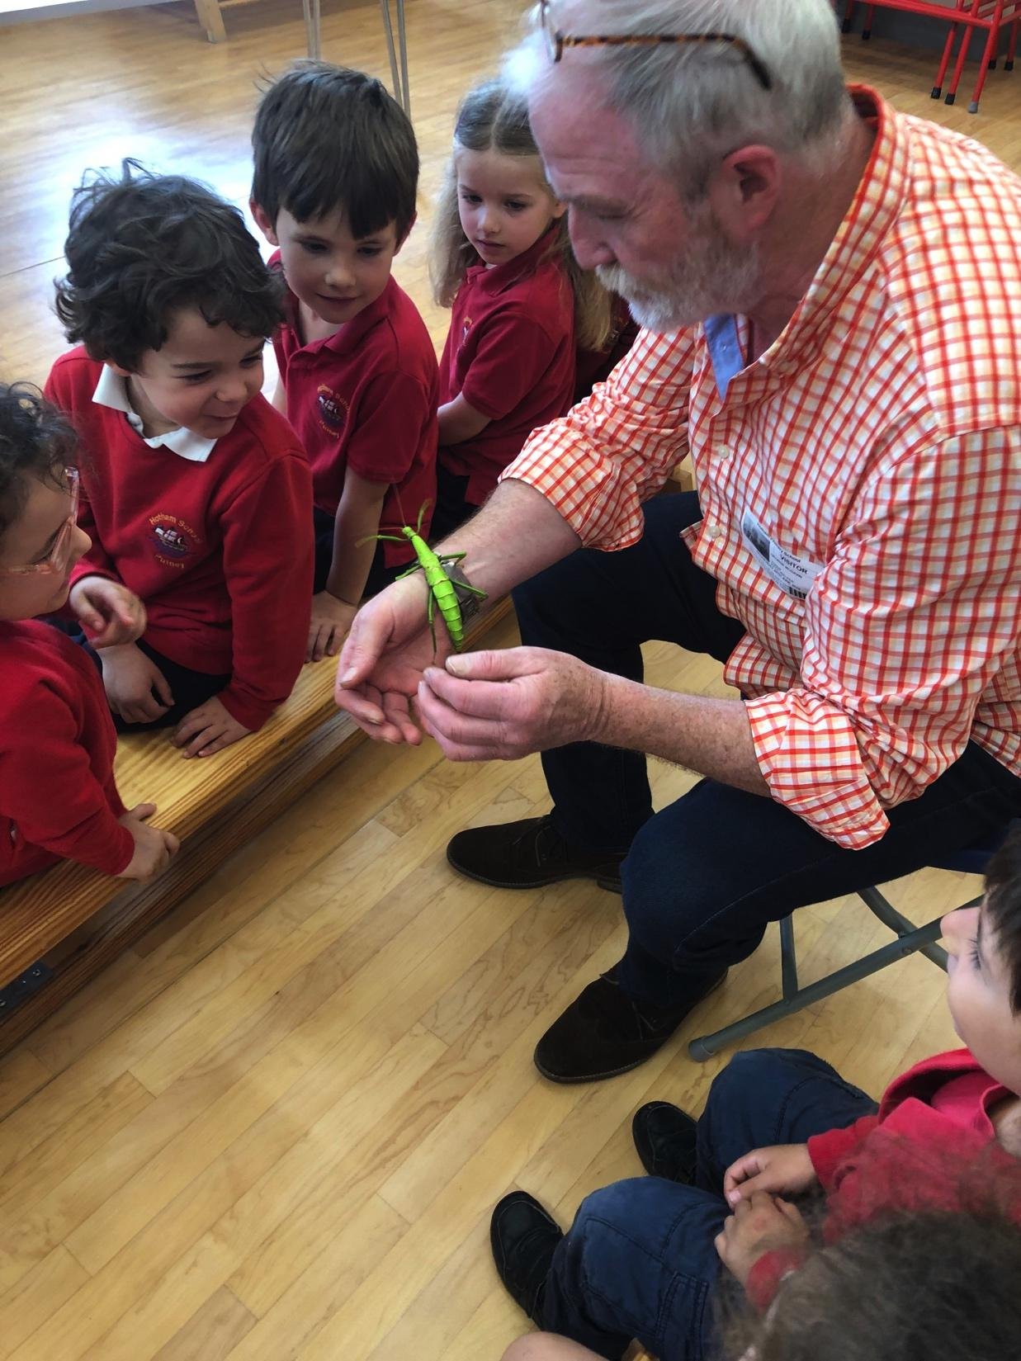
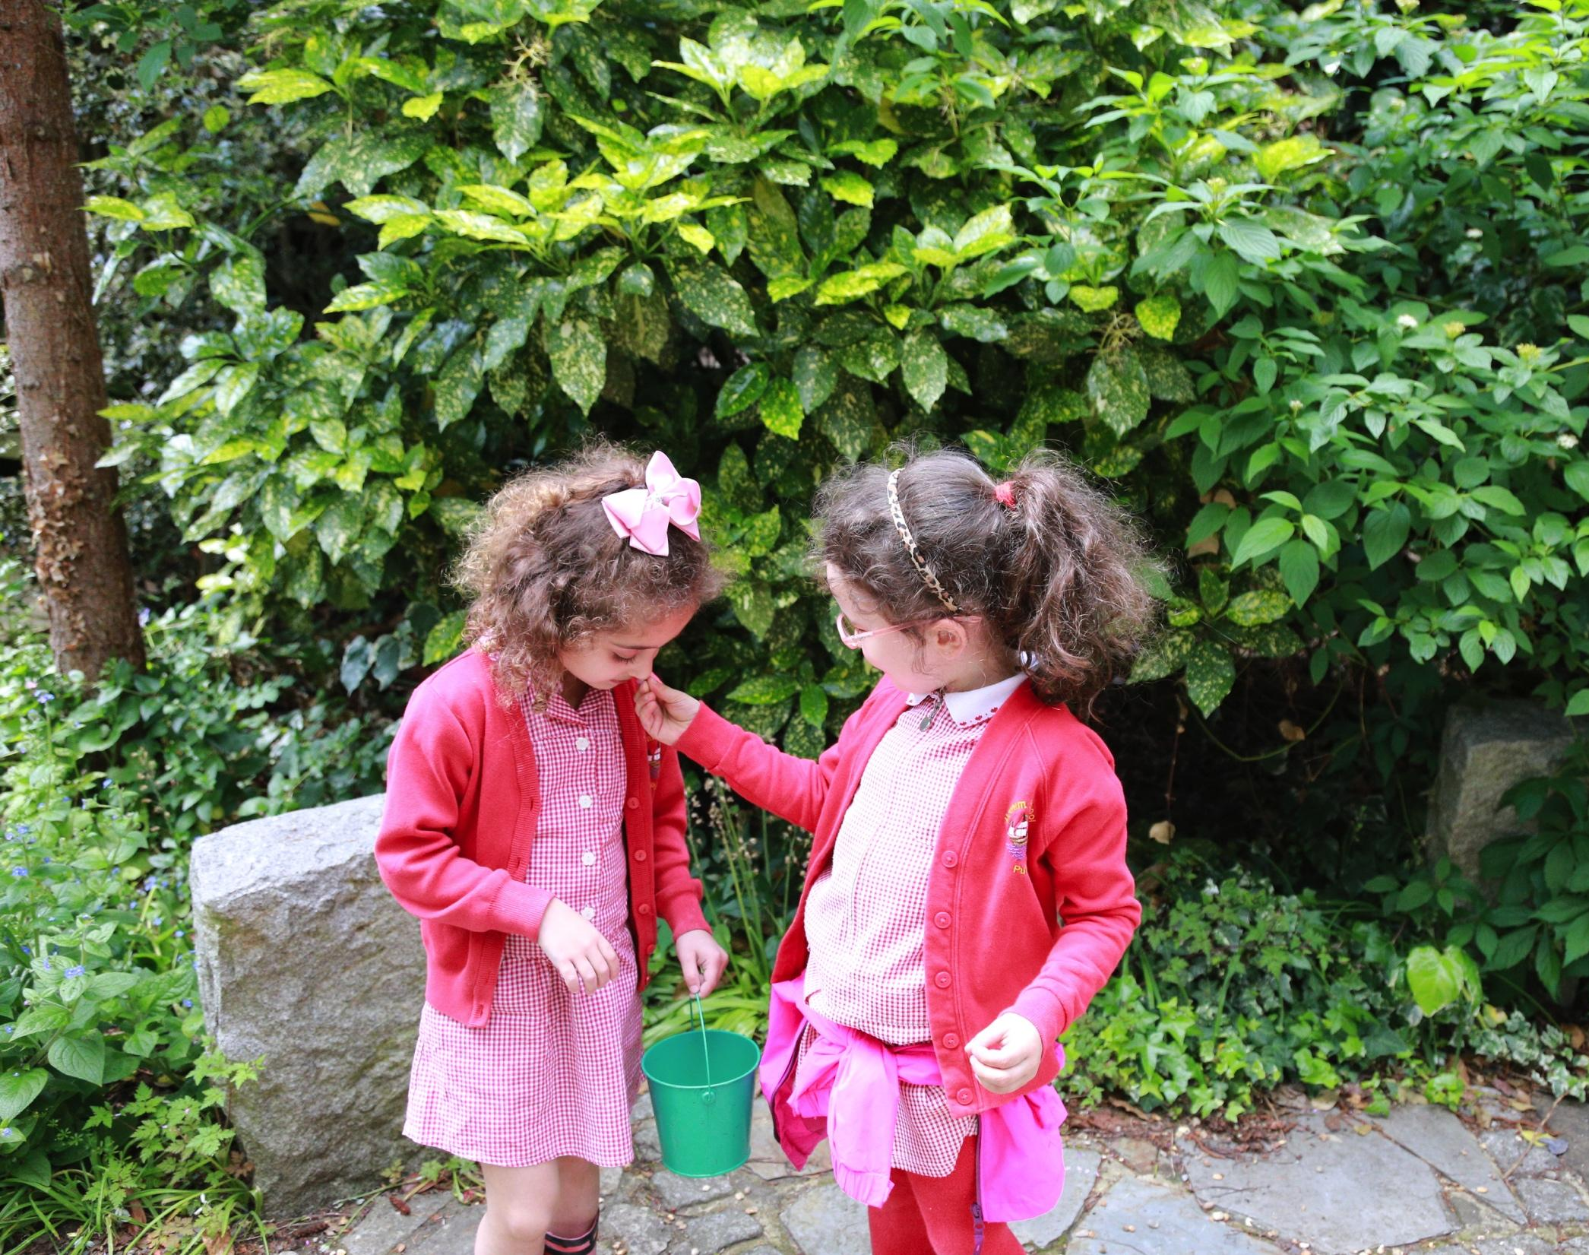

Slide 15
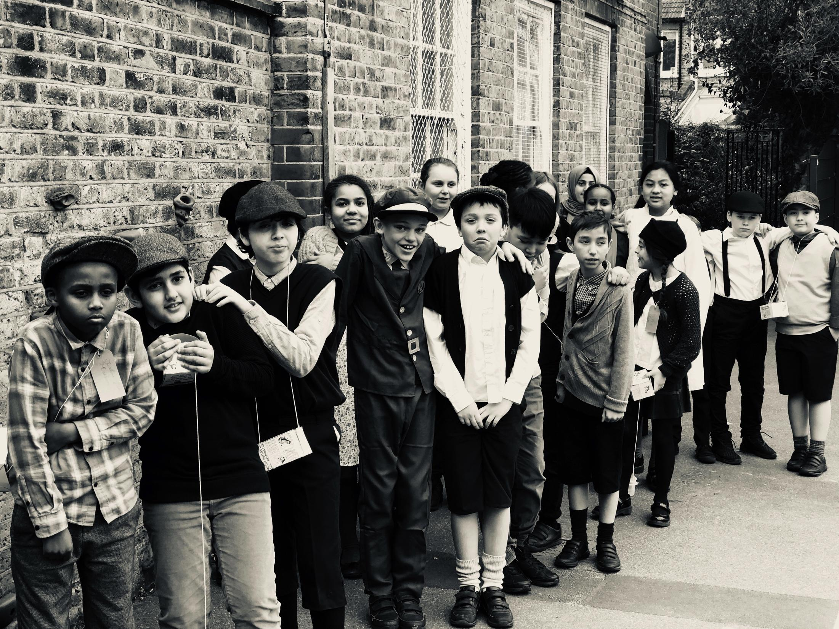
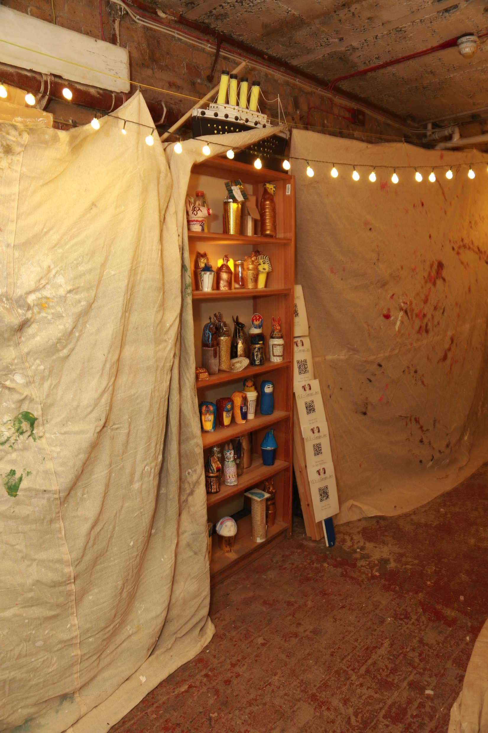

Slide 16
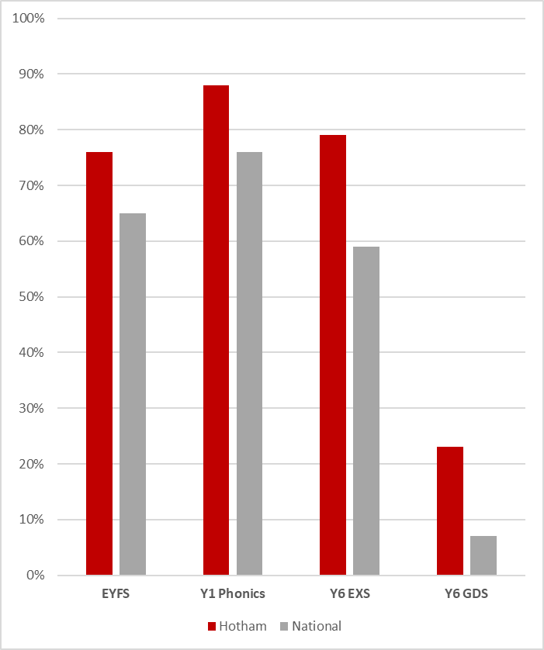
Outcomes
In 2022…
In Early Years, 76% of children reached a Good Level of Development’, compared to 65% nationally.
79% of children left our school in Year 6 at the expected level in Reading, Writing and Maths, compared to 59% nationally
23% achieved this at a higher level, compared to 7% nationally.

Slide 17
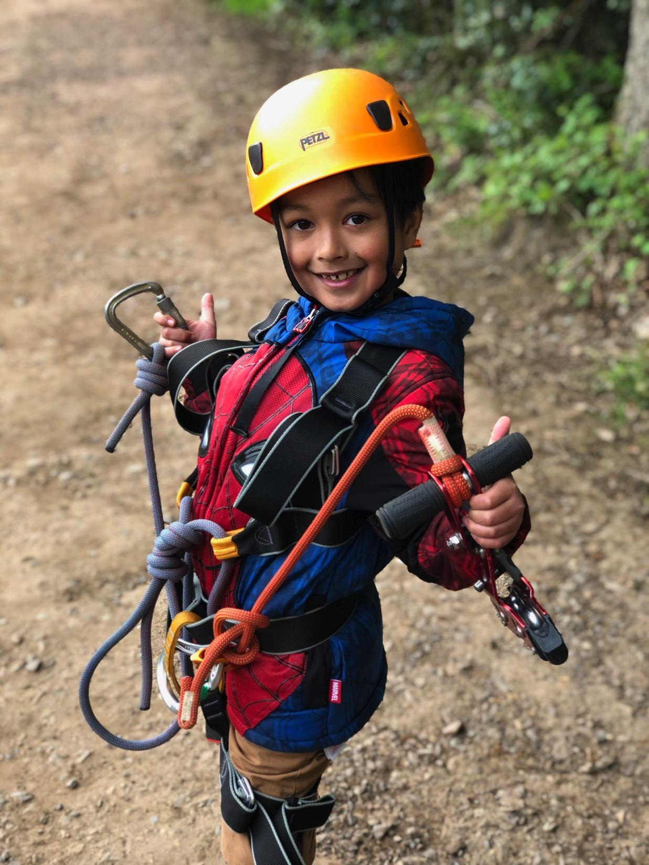
More about us
Music
Sport
Forest school
Parental involvement
Experiences and opportunities
Extra-curricular offer
Wraparound provision

Slide 18
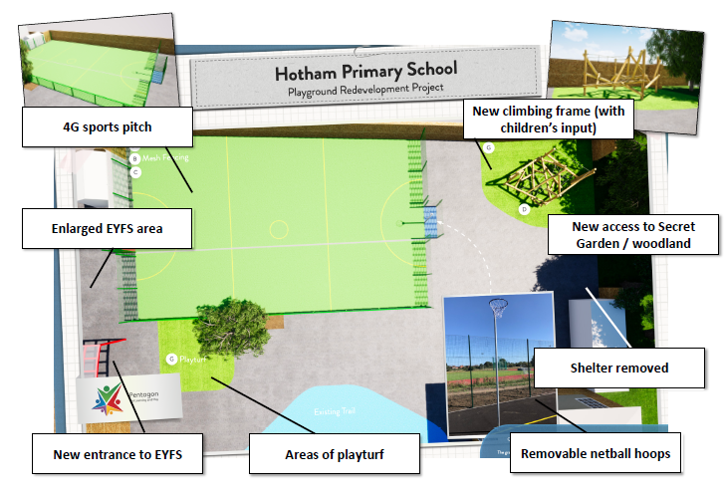

Slide 19
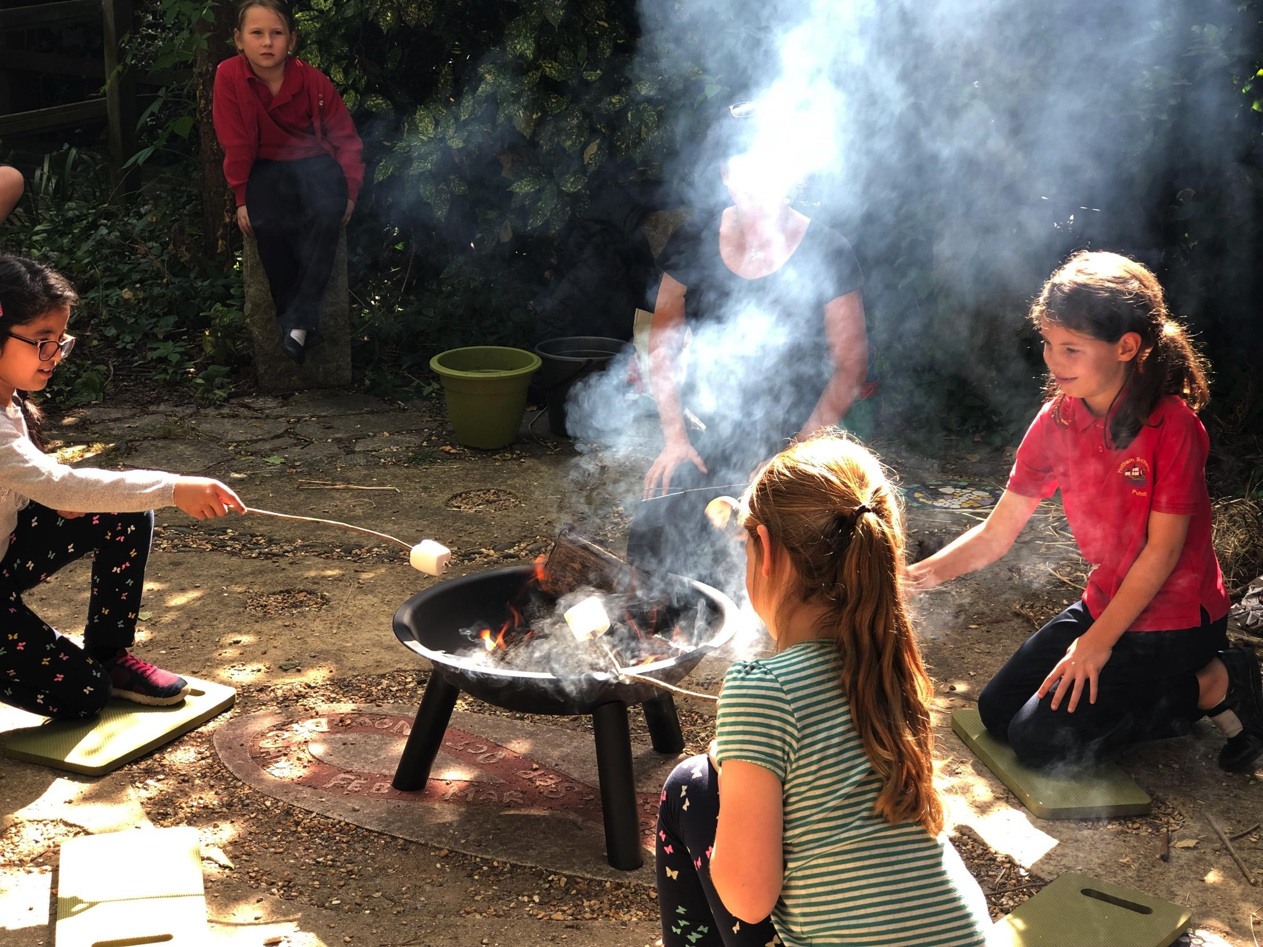
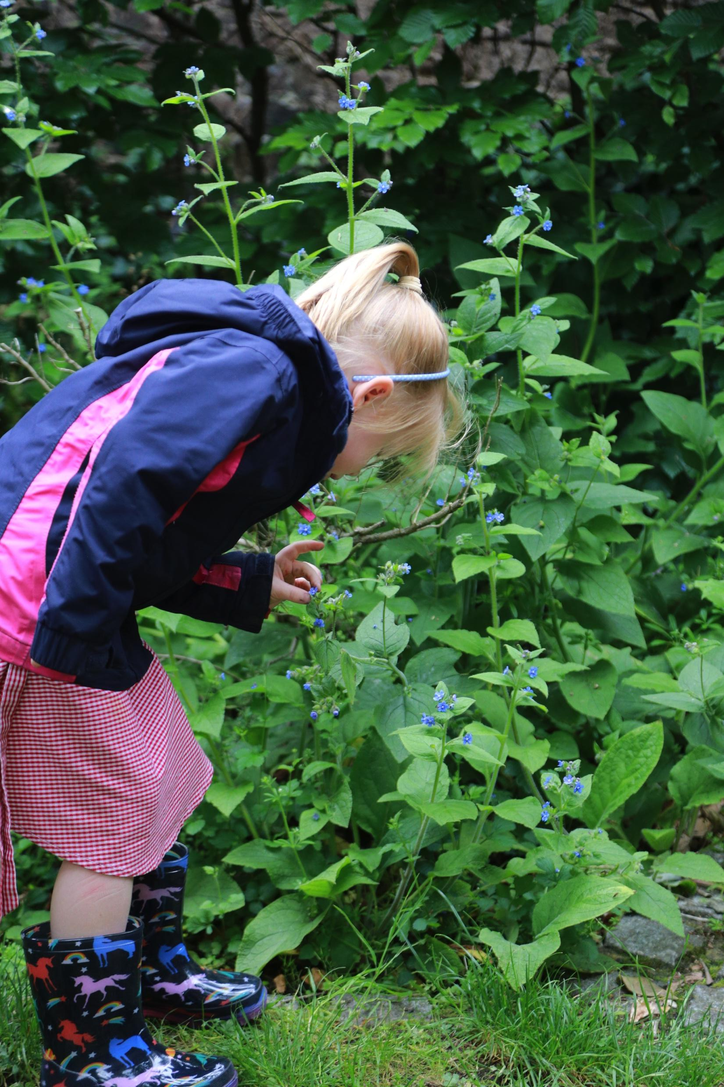

Slide 20
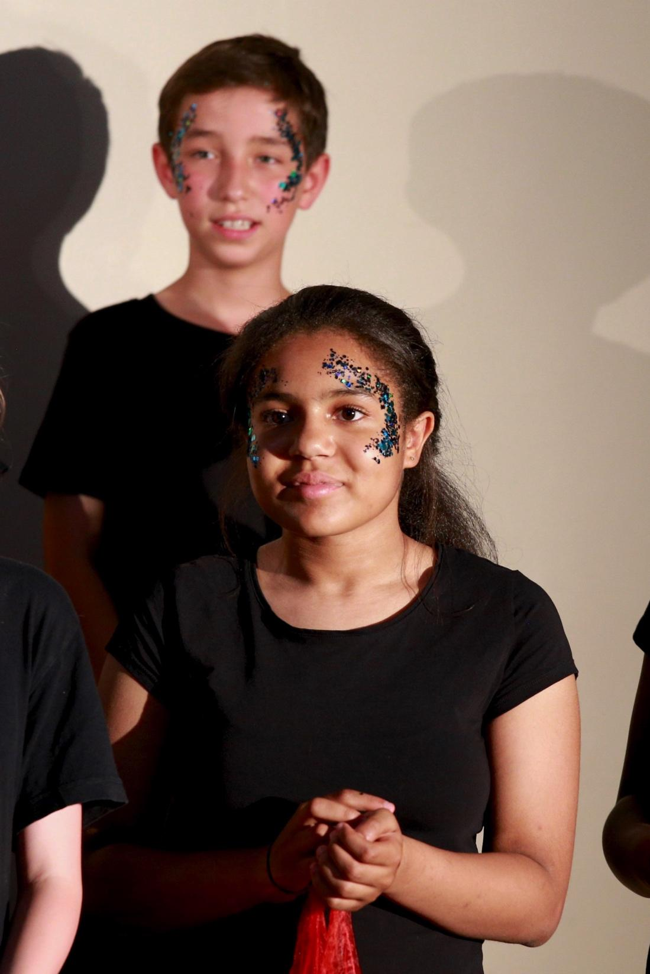
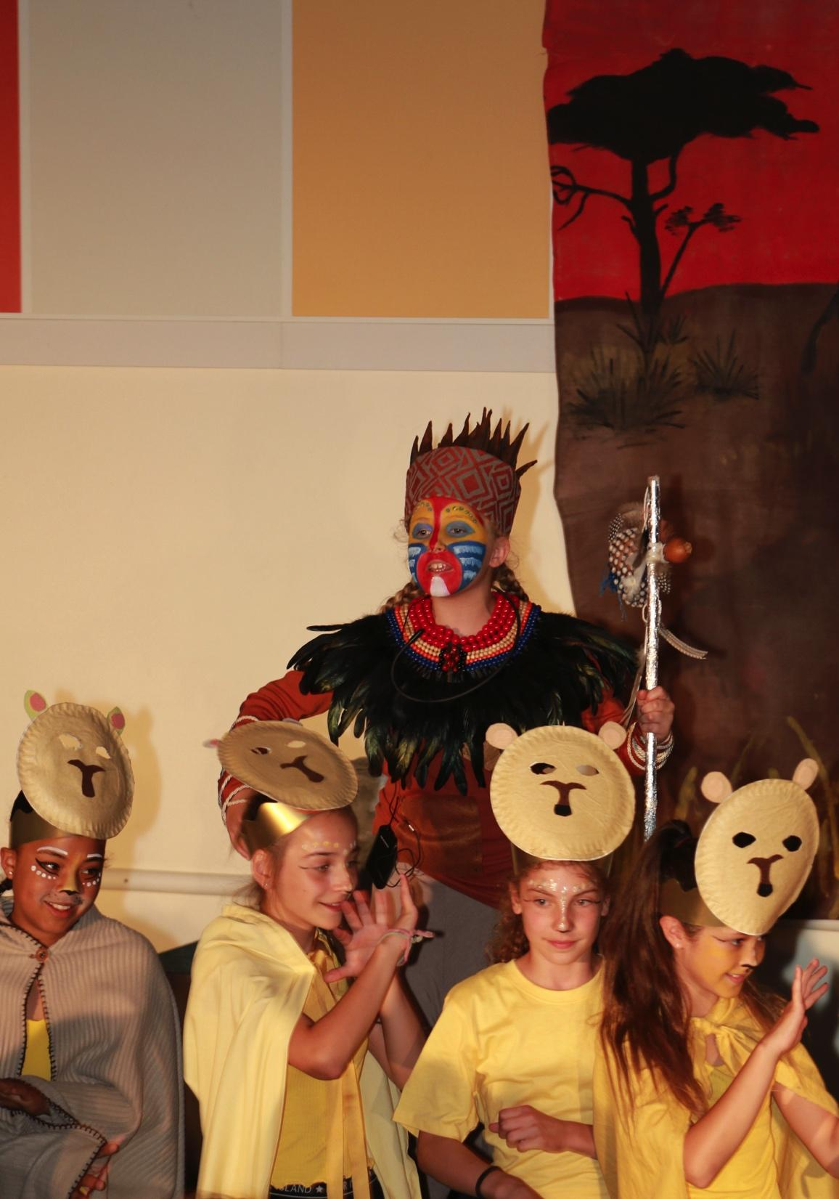

Slide 21
Any questions?

Slide 22
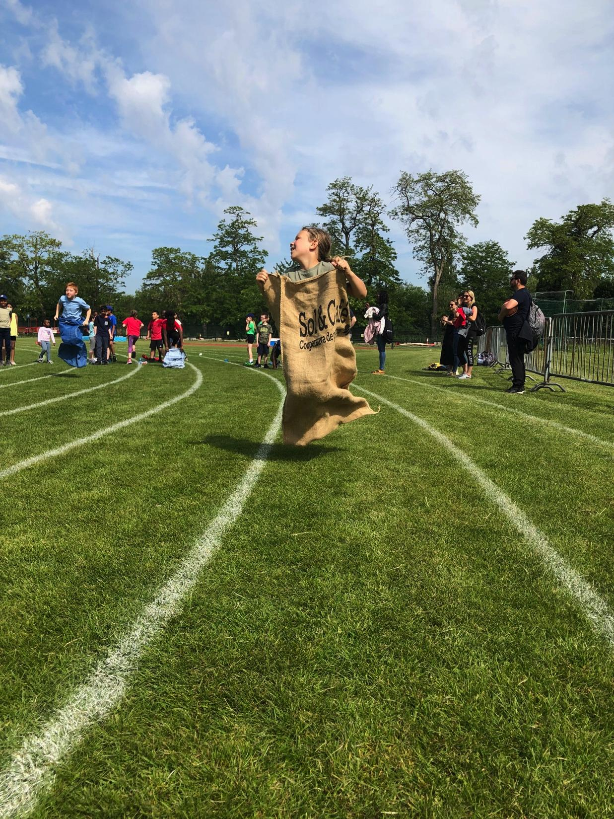
We hope to see you soon

